Slide 1
Category Detection using Amazon Queries
Team members
Sai Mohan Majoju
SaiKumar Jakkula

Slide 2
Introduction
Understanding user intent is crucial in natural language processing (NLP) applications because it enables systems to effectively interpret and respond to user input
Enhanced User Experience
Accurate Information Retrieval
Intent-Based Routing

Slide 3

What is Intent Detection?
Category detection involves analyzing and categorizing user utterances into predefined categories or labels that represent different categories of information or topics. These categories can vary depending on the application or domain. For example, in a news categorization system, categories might include "sports," "politics," "entertainment," or "technology." The goal is to accurately identify the appropriate category for each user input, allowing for efficient organization and retrieval of relevant information.

Slide 4
Challenges in Intent Detection
Ambiguity in user queries
Variations in language and phrasing
Handling out-of-vocabulary words
Dealing with noisy or incomplete data

Slide 5

Why BERT for Category Detection?
BERT is typically pretrained on a large corpus of text data using unsupervised learning. This pretraining enables BERT to learn general language representations that can be fine-tuned for specific tasks like intent detection.
BERT's bidirectional nature allows it to capture contextual information effectively. It can understand the meaning of a word based on its surrounding words, which is beneficial for intent detection, as it enables the model to consider the full context of the user query.

Slide 6
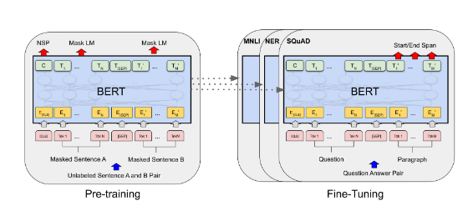
Architecture Overview
BERT can be fine-tuned on specific downstream tasks. The pretrained BERT weights are further trained on task-specific labeled data, allowing the model to adapt and specialize for tasks such as sentiment analysis, named entity recognition, question answering, and more.

Slide 7
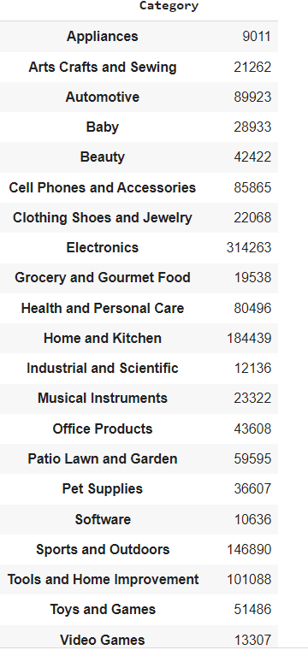
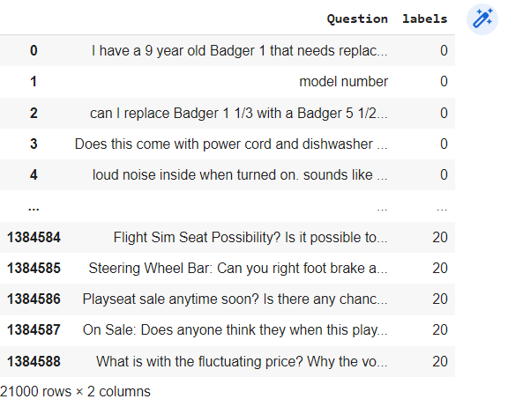
Dataset
The dataset that is used for finetuning the BERT model contains wide variety of questions from users

Slide 8
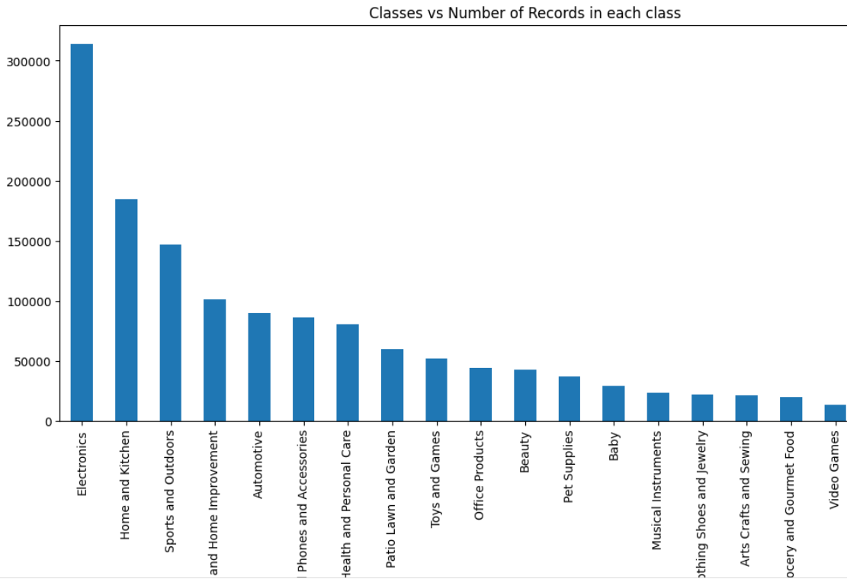
Data Preparation
The below dataset should cover a wide range of intents and include representative examples of user inputs.
https://www.kaggle.com/code/kagarg/chatbot/input?select=multi_questions.csv

Slide 9
Model Training
The queries and the labels which are related to the queries are passed to the BRET
The model will be trained on the trained data and tested on the validation data
The loss of the model is monitored in each epoch

Slide 10
Evaluation Methodology
We adopt our model two metrics including Exact Match (EM) and Fl scores to evaluate our model.
The EM score determines the percentage of predictions that perfectly match the ground truth answer, and the Fl score demonstrates the average overlap between the prediction and the ground truth answer.

